Slide 1
GITHUB TOOL
A comprehensive framework for designing, improving, implementing, and assessing a Machine Learning tool for automatizing abstract screening in Systematic Literature Reviews

Slide 2
 | Script name | Requirements before input | Input | Output
1 | query_retrieval_sampling.py | -Query -Sample size (percentage) -KEY and TOKEN of Scopus API | -Query search in TITLE-ABS-KEY -Limit Year -Sample size (percentage) -Directory -Journals and/or proceedings | In npz file: -Citations (Title, Abstract, Journal, Publishing Date, DOI, EID) -Citation Sample -Missing citations (EID) -Error citations (EID) In csv file: -Citations (Title, Abstract, Journal, Publishing Date, DOI, EID) -Citation Sample
2 | n_grams.py | -Min Frequency (of UNI-grams to be considered) -To label citations in sample of csv file as included (1) or excluded (0) | -Directory -Labelled Citation Sample in csv file -Min Frequency (of UNI-grams to be considered) | In csv file: -Collection of UNI-grams
3 | vectorization_split.py | -Revise collection of UNI-grams in csv file | -Directory -Labelled Citation Sample in csv file -Collection of revised UNI-grams in csv file -Citations | In npz file: -Vectorized data set split into training and testing sets -Vectorized citations
4 | train_test.py | -Experimental Design for a LR with L2 penalty | -Directory -Feature size using RFE feature selection -Proportion of positives using Naïve Oversampling -Proportion of positives using Naïve Undersampling -Multicollinearity threshold -Outlier covariance threshold -No. of splits for Cross Validation -Vectorized data set split into training and testing sets -Vectorized citations | In npz file: -Best model -Vectorized citations with new features
5 | implementation_acceptance_sampling.py | -Acceptance sampling plan (n,c) -Citation interval step -Initial threshold for sampling | -Directory -Best model -Vectorized citations with new features -Citation interval step -n parameter -Initial threshold for sampling | In csv file -Citations with predicted probability of inclusion (sorted) -Citations sampled from each citation interval

Slide 3

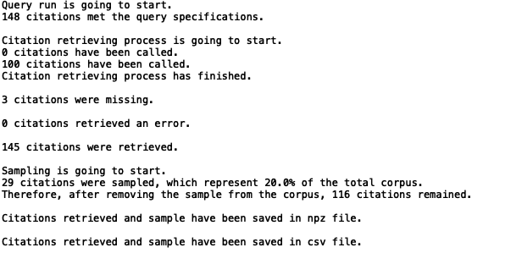
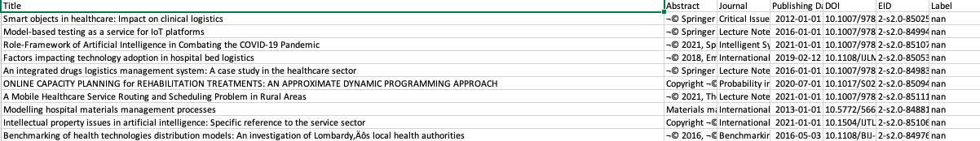
query_retrieval_sampling.py
Input
Printing output
csv output

Slide 4

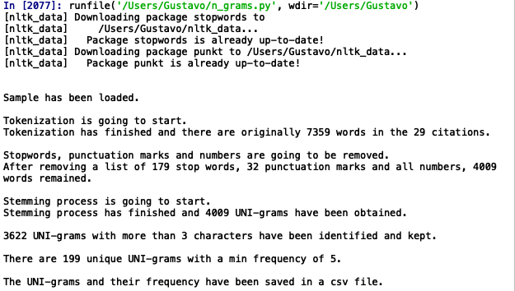
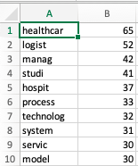
n_grams.py
Input
Printing output
csv output

Slide 5

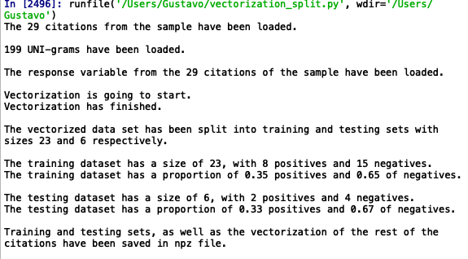
vectorization_split.py
Input
Printing output

Slide 6
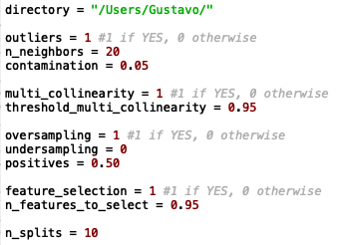
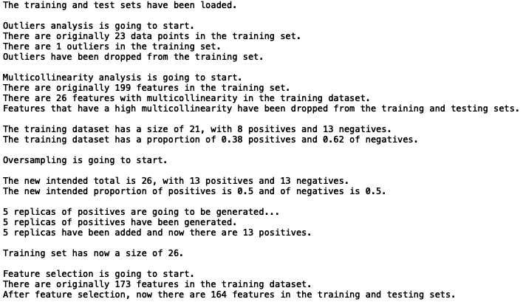
train_test.py
Input
Printing output

Slide 7
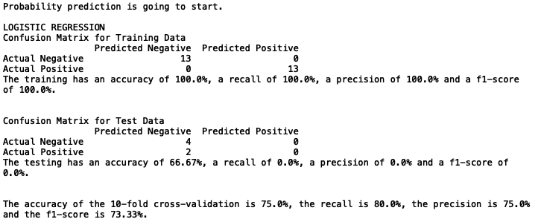

train_test.py
Printing output

Slide 8

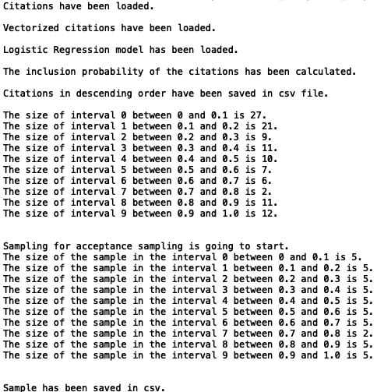
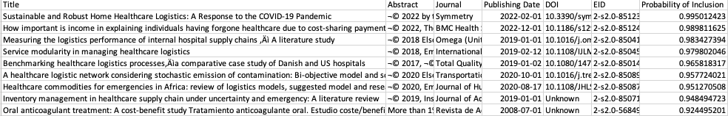
Input
Printing output
csv output

